Slide 1
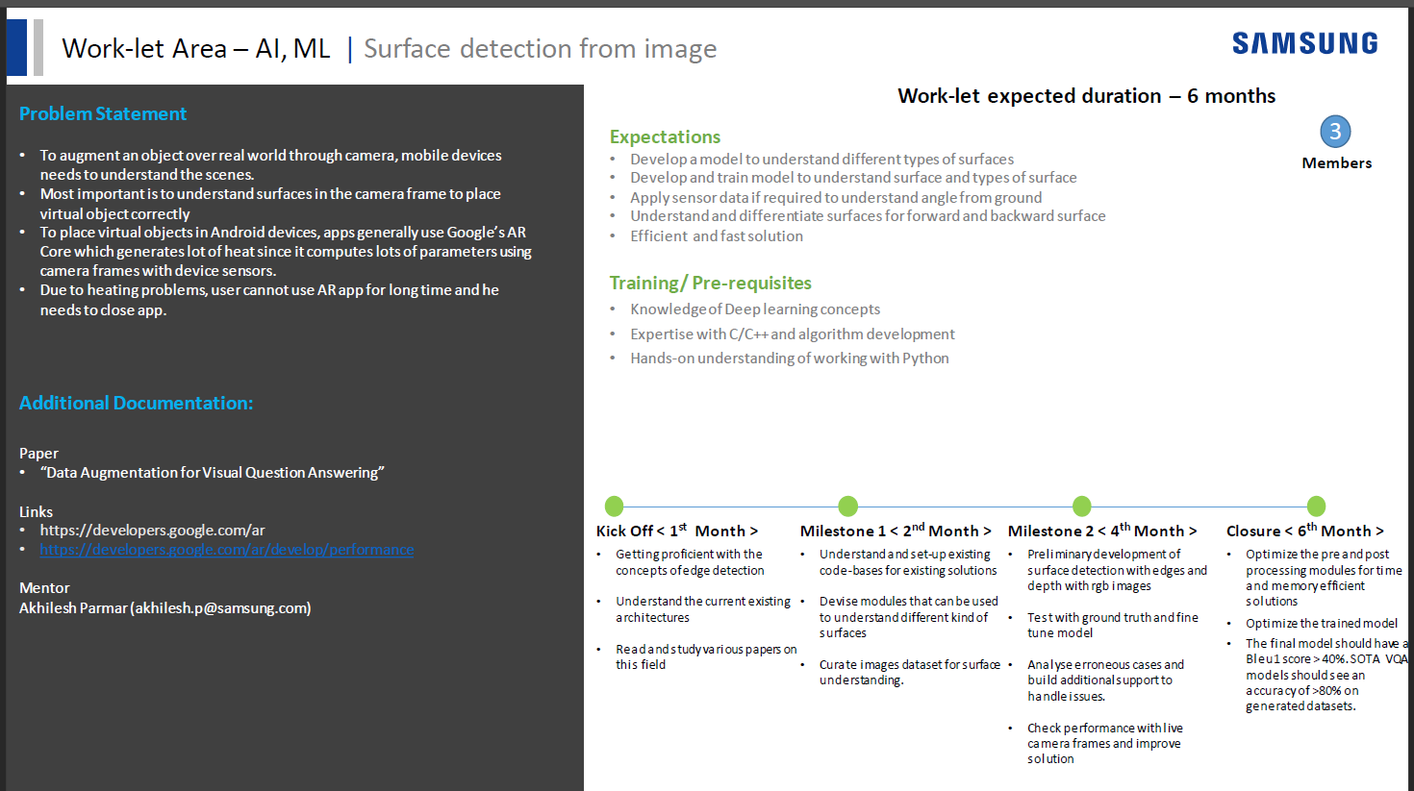
1

Slide 2

[Samsung PRISM] Preliminary Discussion
Surface detection from Image
Team
College Professor(s): Dr. Sini Anna Alex and Dr. Rajarajeswari S
Students:
Harsha Aryan(ECE)
Shakthi Varun(ECE)
Rahul Kumar(ECE)
Satyam Satyarthi(ECE)
Pranamya Kashyap MP(CSE)
Date: 21 Jan 2022
2

Slide 3
Work-let Name: Surface Detection From Images
Worklet Details
Worklet ID: ATL23MS
College Name: RAMAIAH INSTITUTE OF TECHNOLOGY
Implementation of Edge Detection Algorithm.
Literature Survey.
Perfect Positioning of Objects in AR.
Augmented Reality Search.
KPIs achieved till now
Any Challenges/ Issues faced
Papers discuss surface defect detection and not surface detection itself.
Next Steps
Further research on existing Architectures.
Work on Image Processing.
Implementation of Code Base.
Worked with existing libraries on Edge Detection.
Understood concepts of Surface Detection.
Understood ARCore and it’s applications.
Studied different approaches to Edge detection.
Outcomes till now
Date: 21 Jan 2022
3

Slide 4
Agenda
Introduction
Problem Statement
Objectives
Work Done So far
Literature Survey
Outcomes Till Now
References

Slide 5
Introduction
In 3D computer graphics, hidden-surface determination is the process of identifying what surfaces and parts of surfaces can be seen from a particular viewing angle.
A hidden-surface determination algorithm is a solution to the visibility problem, which was one of the first major problems in the field of 3D computer graph.
Hidden-surface determination is necessary to render a scene correctly, so that one may not view features hidden behind the model itself, allowing only the naturally viewable portion of the graphic to be visible.

Slide 6
Problem Statement
To augment an object over real world through camera, mobile devices needs to understand the scenes.
Most important is to understand the surfaces in the camera frame to place virtual object correctly.
To place virtual object in android devices, apps generally use AR core which generates lot of heat since it computes lot of parameters using camera frames with device sensors.
Due to heating problems, users cannot use AR app for long time and he needs to close app Current Methodology

Slide 7
Project Objectives
Understand various types of surfaces
Identify different methods to detect surfaces and types of surface.
Evaluate the performance of identified methods to find the most efficient solution.

Slide 8
Literature survey
Major Observations / Conclusions:
(provide details about your findings, experimental opinion – Use separate slide if necessary)
AR core: SDK used to add AR capabilities to android devices.
Motion Tracking Plane Finding Depth Understanding Light Estimation
Plane Finding: Locates a cluster of feature points that lie on a common horizontal surface and provides a virtual plane. That mobile apps can interact with.
This is the concept, our Project is focused on.
Data Augmentation for VQA:
Neural Networks performance correlates to the amount of training datasets.
Augment existing datasets using template or generative method to train more with the same data.
Image processing- Edge detection: Mathematical models that identify edges and curves from digital images.
8

Slide 9
Literature survey
Sl.no | Title | Author name | Link | Method used | Outcome | Research gap (if any)
1 | A Method for Detection of Walls and Large Flat Surfaces in Through-the-Wall SAR Imaging | Behzad Yektakhah and Kamal Sarabandi | Click Here | using synthetic aperture radar (SAR) for high resolution images | A method to discriminate walls and objects with large flat surfaces from limited size objects and determine the existing walls locations and orientations inside the imaged area. | forming the image using the entire large aperture has a destructive effect on the image of some points on the wall surface.
2 | Surface Detection in 3D Images Using Cellular Logic Array Processing | G. Ramesh Chandra,G. Sathya,E. G. RajanE. G. Rajan,Michael P. Coyle | Click Here | Cellular Logic Array Processing (CLAP) based 3-D surface detection algorithm. | Comparison between various 3D surface detection algorithms based on time complexity.
3 | AR Mobile Video Calling System Based on WebRTC API | Lei Yang, Meng Guo, Jiayi Xu | Click Here | WebRTC protocol for establishing real-time video communication and uses AR SDK such as Google AR Core for adding AR features | Implementation on actual device for stability and reliability checkup
4 | Novel Accurate Core Loss Test Method for Powder Core Materials in Power Electronics Conversion | CHEN Wei, HE Jiannong and YANG Xiangdong | Click Here | method, named as DC power meter method, is presented and its calibration method | overcomes the error problems caused by large impedance angle of the DUT | core loss test of powder core and under practical PWM excitations cannot be completely removed

Slide 10
Literature survey
Sl.no | Title | Author name | Link | Method used | Outcome | Research gap (if any)
5 | MemSeg: A semi-supervised method for image surface defect detection using differences and commonalities | Minghui Yang, Peng Wu, Jing Liu, and Hui Feng | Click here | memory-based segmentation network | This method achieves AUC scores of 99.56% and 98.84% at the image-level and pixel-level, respectively | MemSeg requires more memory samples to memorize more normal patterns
6 | Depth image-based plane detection | Zhi Jin, Tammam Tillo, Wenbin Zou, Xia Li1 and Eng Gee Lim | Click here | depth image-based plane detection algorithm | 99.78% specificity for threshold
7 | Very Deep Convolutional Networks For Large-scale Image Recognition | Karen Simonyan & Andrew Zisserman | Click here | Uses a CNN popularly known as VGG16 | It has become the standard architecture for edge detection. | The large number of parameters make the network very time consuming to run and it's size, relatively large.

Slide 11
Literature survey
Sl.no | Title | Author name | Link | Method used | Outcome | Research gap (if any)
8 | Dense Extreme Inception Network for Edge Detection | Xavier Soria,, Angel Sappac,, Patricio Humananteb and Arash Arbariniad | Click here | Implemented as a collection of two sub-networks: the dense extreme inception network (Dexi) and the upsampling network (USNet) | Attained an ODS-F score of 0.863 when trained on MDBD dataset and 0.763 on BIPED
9 | Augmented Reality Search to Improve Searching Using Augmented Reality | Fiza Saifan Shaikh | Click here | Augmented reality search | User need not to search the images on Google because user can experience real view on augmented reality search
10 | Augmented Reality and its effect on our life. | Riya Aggarwal,Abhishek Singhal | Click here | four types namely marker based, marker less, projection based and superimposition based augmented reality. | gives us a comparison between the two related topics, Augmented reality and Virtual reality. gives us a comparison between the two related topics, Augmented reality and Virtual reality.

Slide 12
Links to CodeBase:
DexiNed - Deep learning approach to Edge Detection.
Edge Detection using low level features or A signal processing approach to edge detection.

Slide 13
Outcome of the work done
This study helped in knowing about types of surfaces, methods used by various authors to identify various surfaces.
Visual question answering is used for understanding about the scene in most of the scenarios.
Also VQA with other methods helps in generating new related questions.
3D structures are used for identifying the objects in an image. Self supervised learning is used to learn about scenes.
Other methods like memory based segmentation network, feature extraction, synthetic aperture radar, Augmented reality search, data augmentation are used by the authors in order to improve the performance.
Hence this study gives a clear picture of surface type and by using the information gained from it, virtual object can be placed in a proper position with more accuracy.

Slide 14
References
[1]Yang, Minghui, Peng Wu, Jing Liu, and Hui Feng. "MemSeg: A semi-supervised method for image surface defect detection using differences and commonalities." arXiv preprint arXiv:2205.00908 (2022).
[2]Zavrtanik, Vitjan, Matej Kristan, and Danijel Skočaj. "Draem-a discriminatively trained reconstruction embedding for surface anomaly detection." In Proceedings of the IEEE/CVF International Conference on Computer Vision, pp. 8330-8339. 2021.
[3]Stephen, Okeke, Uchenna Joseph Maduh, and Mangal Sain. "A machine learning method for detection of surface defects on ceramic tiles using convolutional neural networks." Electronics 11, no. 1 (2021): 55.
[4]Kumar, Sushil, Meera Sharma, V. B. Singh, and S. K. Muttoo. "Bug Report Classification into Orthogonal Defect Classification Defect Type using Long Short Term Memory." In 2021 3rd International Conference on Advances in Computing, Communication Control and Networking (ICAC3N), pp. 285-287. IEEE, 2021.
[5]Shaikh, Fiza Saifan. "Augmented Reality Search to Improve Searching Using Augmented Reality." In 2021 6th International Conference for Convergence in Technology (I2CT), pp. 1-5. IEEE, 2021.
[6]Islam, Md Mushfiqul, Muhammad Sheikh Sadi, Md Milon Islam, and Md Kamrul Hasan. "A new method for road surface detection." In 2018 4th International Conference on Electrical Engineering and Information & Communication Technology (iCEEiCT), pp. 624-629. IEEE, 2018.
[7]Tabernik, Domen, Samo Šela, Jure Skvarč, and Danijel Skočaj. "Segmentation-based deep-learning approach for surface-defect detection." Journal of Intelligent Manufacturing 31, no. 3 (2020): 759-776.
[8]Maeda, Hiroya, Yoshihide Sekimoto, Toshikazu Seto, Takehiro Kashiyama, and Hiroshi Omata. "Road damage detection using deep neural networks with images captured through a smartphone." arXiv preprint arXiv:1801.09454 (2018).
[9]Zhai, Lijie, and Donghui Chen. "Image real-time augmented reality technology based on spatial color and depth consistency." Journal of Real-Time Image Processing 18, no. 2 (2021): 369-377.
[10]Xiao, Tete, Yingcheng Liu, Bolei Zhou, Yuning Jiang, and Jian Sun. "Unified perceptual parsing for scene understanding." In Proceedings of the European conference on computer vision (ECCV), pp. 418-434. 2018.

Slide 15
References
[11]Pan, Xingang, Jianping Shi, Ping Luo, Xiaogang Wang, and Xiaoou Tang. "Spatial as deep: Spatial cnn for traffic scene understanding." In Proceedings of the AAAI Conference on Artificial Intelligence, vol. 32, no. 1. 2018.
[12]Si, Lipeng, Hao Zhu, and Qing Wang. "Epipolar Plane Image Rectification and Flat Surface Detection in Light Field." Journal of Electrical and Computer Engineering 2017 (2017).
[13]Jin, Zhi, Tammam Tillo, Wenbin Zou, Xia Li, and Eng Gee Lim. "Depth image-based plane detection." Big Data Analytics 3, no. 1 (2018): 1-18.
[14]Yektakhah, Behzad, and Kamal Sarabandi. "A method for detection of walls and large flat surfaces in through-the-wall SAR imaging." In 2019 IEEE International Symposium on Antennas and Propagation and USNC-URSI Radio Science Meeting, pp. 815-816. IEEE, 2019.
[15]Andreas, Jacob, Marcus Rohrbach, Trevor Darrell, and Dan Klein. "Learning to compose neural networks for question answering." arXiv preprint arXiv:1601.01705 (2016).
[16]Zheng, Jia, Junfei Zhang, Jing Li, Rui Tang, Shenghua Gao, and Zihan Zhou. "Structured3d: A large photo-realistic dataset for structured 3d modeling." In European Conference on Computer Vision, pp. 519-535. Springer, Cham, 2020.
[17]Lim, Changmin, Chanran Kim, Jong-II Park, and Hanhoon Park. "Mobile augmented reality based on invisible marker." In 2016 IEEE International Symposium on Mixed and Augmented Reality (ISMAR-Adjunct), pp. 78-81. IEEE, 2016.
[18]Goyal, Priya, Dhruv Mahajan, Abhinav Gupta, and Ishan Misra. "Scaling and benchmarking self-supervised visual representation learning." In Proceedings of the ieee/cvf International Conference on computer vision, pp. 6391-6400. 2019.
[19]Kafle, Kushal, Mohammed Yousefhussien, and Christopher Kanan. "Data augmentation for visual question answering." In Proceedings of the 10th International Conference on Natural Language Generation, pp. 198-202. 2017.
[20]Shijie, Jia, Wang Ping, Jia Peiyi, and Hu Siping. "Research on data augmentation for image classification based on convolution neural networks." In 2017 Chinese automation congress (CAC), pp. 4165-4170. IEEE, 2017.

Slide 16
Thank you

